Slide 1
The Software Testing Pyramid: A Concrete Example
Jim Weaver
Vanderbilt University Medical Center
(weaver.je@gmail.com)
Source Code and Tests
https://github.com/weaverj/testpyramidexample

Slide 2
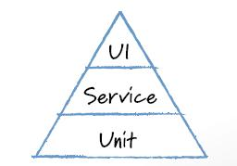
Mike Cohn’s Test Pyramid
Automated tests at three levels.
Foundational base of unit tests.
Minimum necessary tests through user interface.
Service testing in the middle – testing services provided by the application independent of the UI.

Slide 3
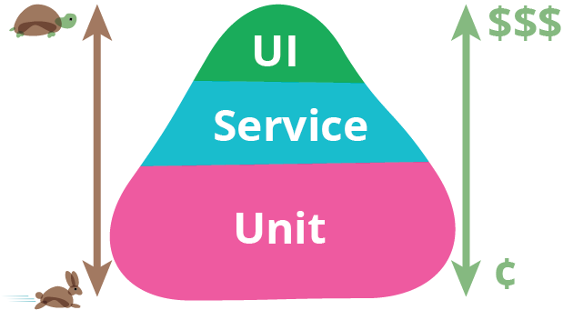
Motivations

Slide 4
The Three Layers of the Pyramid
Unit | Service | UI

Slide 5
Challenges
Team must have a shared understanding of the purpose of the various test layers.
Decisions must be made as to what parts of a feature to test how and in each layer.
Customer participation with service level tests may be hard to obtain.
Communication issues between different test authors resulting in duplication or gaps.

Slide 6
How?
Summarize presentation

Slide 7
Sample feature / system

Slide 8
Planning

Slide 9
Tasks / Tests

Slide 10
Service Tests

Slide 11
Unit Tests / Implementation

Slide 12
UI Tests

Slide 13
Summary

Slide 14
References

